Slide 1
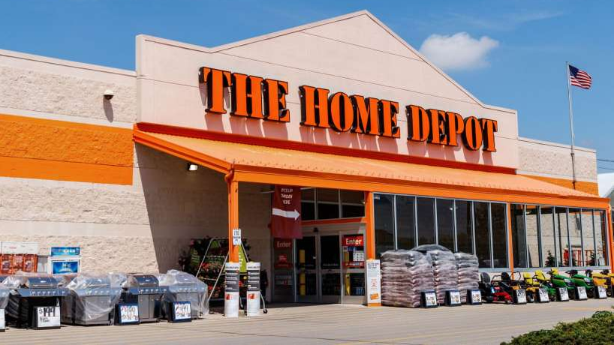
Brief company review - Saloni Shah

Slide 2


Who is Home Depot? Ticker – HD on NYSE
Sell various building materials, home improvement products, lawn and garden products, and décor products,
Provides installation, home maintenance, and professional service programs to do-it-yourself
Acts as a general contractor to provide installation services to its do-it-for-me customers through third-party installers
Largest Home improvement retailer in the USA
2294 stores including the USA, Canada and Mexico
110.2 Billion in revenue in 2019
Employees more than 400,000 associates
More than 35,000 products in store & 1 million products online
Ranks 21 at the Fortune most admired list

Slide 3
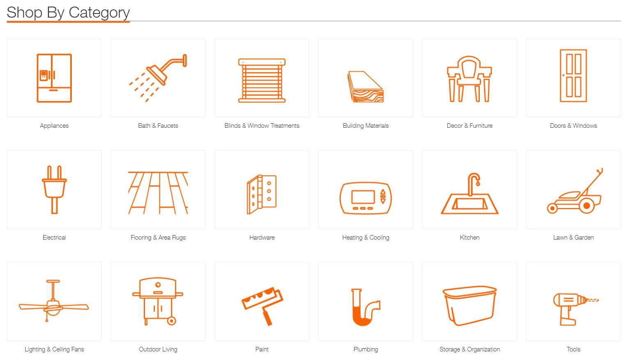
Product Categories

Slide 4
The Home Depot’s History
In 1978, Home Depot Inc was incorporated in Delaware after two men Bernie Marcus and Arthur Blank were fired from Handy Dan Improvement centers
1979, The first two Home Depot stores opened on Memorial Drive and Buford Highway in Atlanta, GA
In 1981, The Home Depot stock went public on NASDAQ at $12 per share
In 1990, it became the largest home improvement retailer in the U.S.
In 2000, Established e-commerce site with test markets in Las Vegas, NV
In 2010, became the first brick-and-mortar retailer with apps on the top three smartphone platforms
In 2015, announced the acquisition of Interline Brands, Inc
In 2017, sales surpassed $100 billion for fiscal year 2017

Slide 5
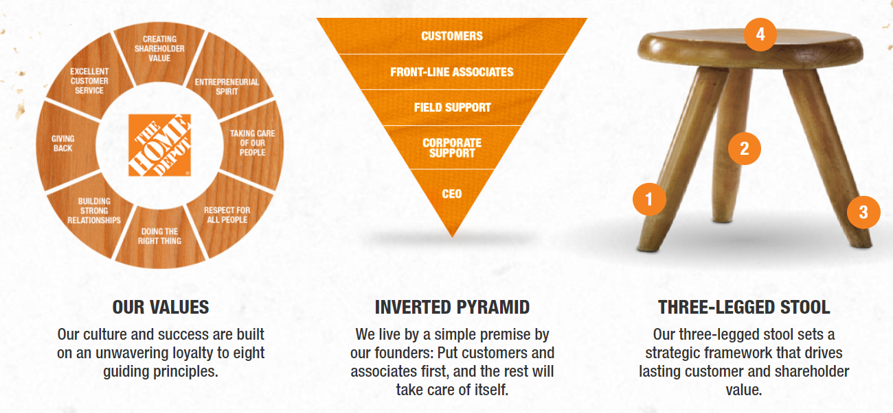
Governing Principles
Interconnected retail
Product Authority
Customer Experience
Capital Allocation, Smarter Investments

Slide 6

ESG Contribution
To date in 2020, The Home Depot Foundation has committed $4 million to disaster response in areas impacted by tornadoes, wildfires and hurricanes. Most recently, the Foundation committed up to $500,000 in support of Hurricane Laura relief, mobilized more than 1,000 disaster relief kits to Lake Charles, La., and helped served nearly 1,300 meals to residents in need from the local Home Depot parking lot in partnership with World Central Kitchen.
Since 2011, the Foundation has invested nearly $350 million in veteran causes and improved more than 47,000 veteran homes and facilities in 4,500 cities. In 2018, the Foundation pledged an additional $250 million to veteran causes taking the total commitment to half a billion by 2025
Notes:
Home Builders Institute Home Builders Youth CONSTRUCTION EDUCATION FOUNDATION OF GEORGIA (CEFGA)
ATLANTA TECHNICAL COLLEGE (ATC)

Slide 7

ESG Contribution
In 2019 alone the Foundation committed more than $3.4 million to disaster response in areas impacted by fires, hurricanes and flooding.
The Home Depot and The Home Depot Foundation are committed to educating more people in the skilled trades and helping them find careers in the home improvement industry. With hundreds of thousands of open roles in the trades nationally, we can’t tackle this work alone. Industry leaders like Home Builders Institute (HBI), Construction Education Foundation of Georgia (CEFGA) and Atlanta Technical College (ATC) are helping us prepare skilled people for these opportunities

Slide 8

Sustainability

Slide 9

Sustainability

Slide 10

Given back to the community

Slide 11

Community Health care

Slide 12
Current Affairs
The Home Depot, the world's largest home improvement retailer, is introducing a Hurricane & Storm Preparedness Livestream Workshop led by expert associates to help residents in storm-prone regions prepare and protect their families and homes for hurricanes, tornadoes and floods.
The first Hurricane & Storm Preparedness Workshop will livestream beginning on Sept. 14, with a new broadcast airing weekly through the end of November. Registration is available at
During the class, a Home Depot associate will show viewers how to put together an emergency supply kit, take proper safety precautions, track storm trajectories, minimize home damage, safely use a generator, access resources from relief organizations, and provide information for potential repairs and recovery from an emergency.

Slide 13
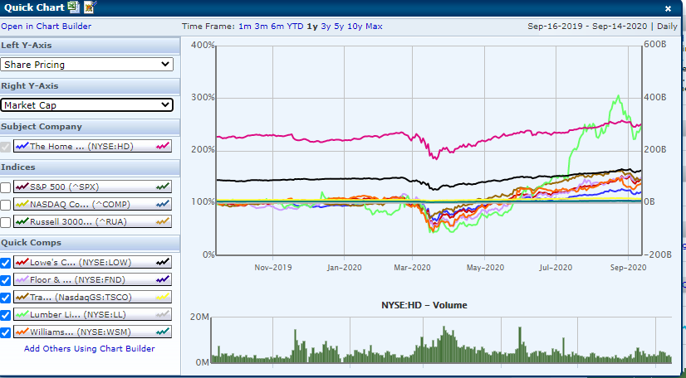
Market Capitalization

Slide 14
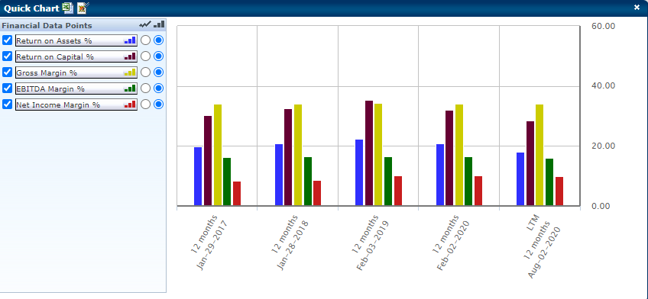
Returns

Slide 15
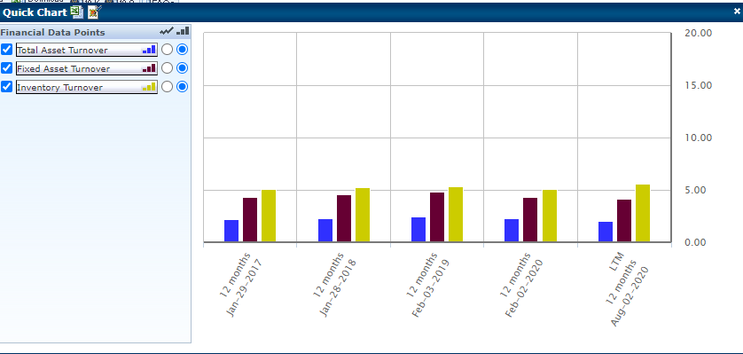
Efficiency Ratios

Slide 16
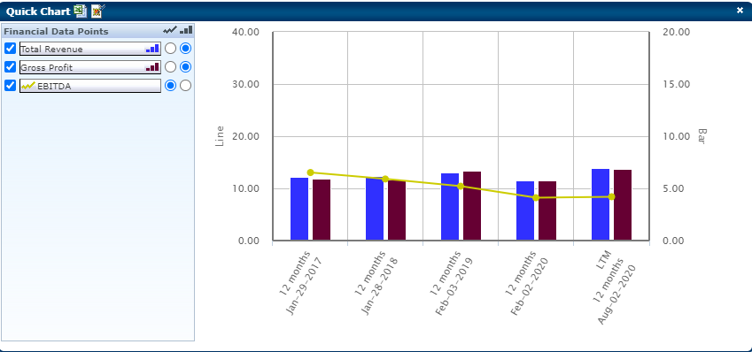
Profitability

Slide 17
Recommendation
Based on the creditability and the generous dividend policy, it is recommended to buy home depot stock

Slide 18
Thank you Q & A?

